Slide 1


Slide 2

Agenda
Introduction
Data sources
Auditing process
Timeline reminders
Most frequently asked questions
Q&A

Slide 3
Introduction

Slide 4
Data sources

Slide 5
Overall physical activity
HBSC data portal: Moderate-to-vigorous physical activity
Data from last HBSC survey (collected in 2021/2022) is available
Inequity data!!
  By age (11, 13, 15), gender, and family affluence (proxy for socioeconomic status)
  Significant differences (at P < 0.05) are provided
Not accurately assessing the most recent WHO guidelines/the Global Matrix benchmark: Participants were asked to report the number of days over the past week during which they were physically active for a total of at least 60 minutes. The question was introduced by text defining moderate-to-vigorous physical activity (MVPA) as any activity that increases the heart rate and makes the person get out of breath some of the time, with examples provided. Findings presented here show the proportions who report at least 60 minutes of MVPA daily.
No open access report on children and adolescent with disabilities – maybe available upon request?

Slide 6
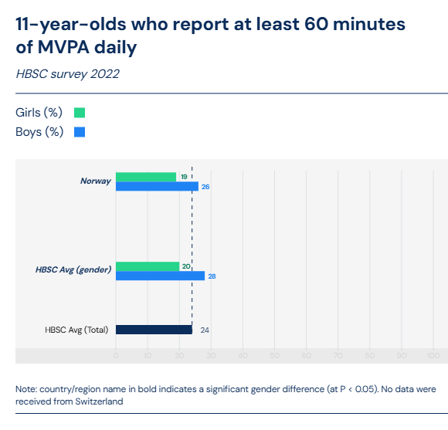
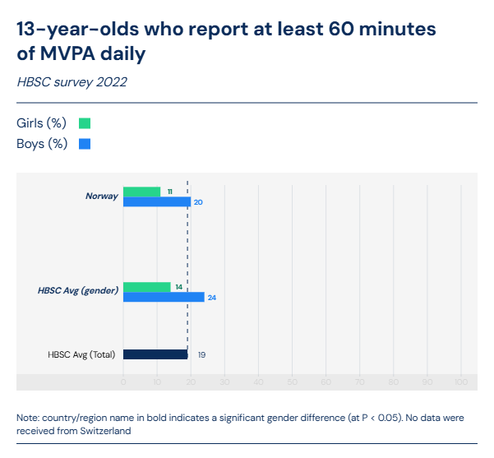
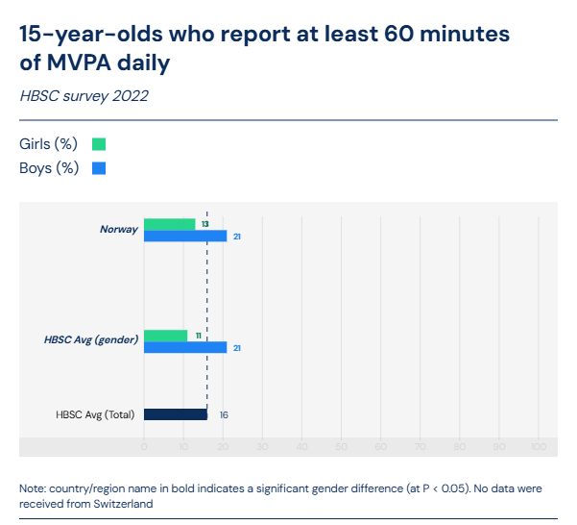
Overall physical activity
HBSC data portal: Moderate-to-vigorous physical activity

Slide 7
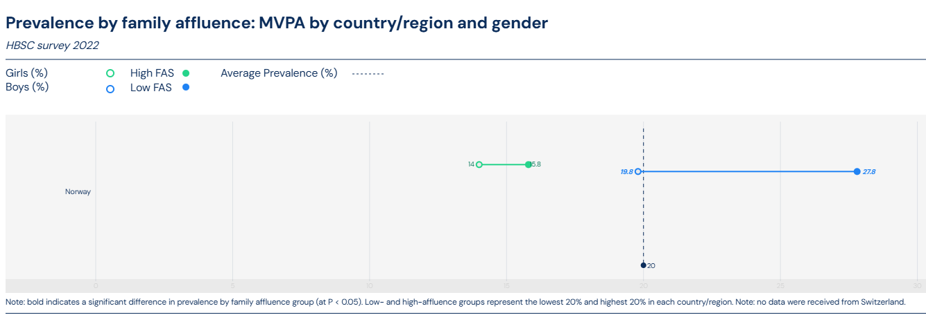
Overall physical activity
HBSC data portal: Moderate-to-vigorous physical activity

Slide 8
Overall physical activity
Global school-based student health survey (GSHS) national factsheets available on the WHO data portal: https://www.who.int/teams/noncommunicable-diseases/surveillance/data
Data for 13-17 years
No international data collection round, limitations in the standardization and translation of questionnaire & methods (sometime, PA questions missing, e.g. Malawi 2009)
Gender differences
Not accurately assessing the most recent WHO guidelines/the Global Matrix benchmark: “Percentage of students who were not physically active for a total of at least 60 minutes per day (during the 7 days before the survey).”

Slide 9
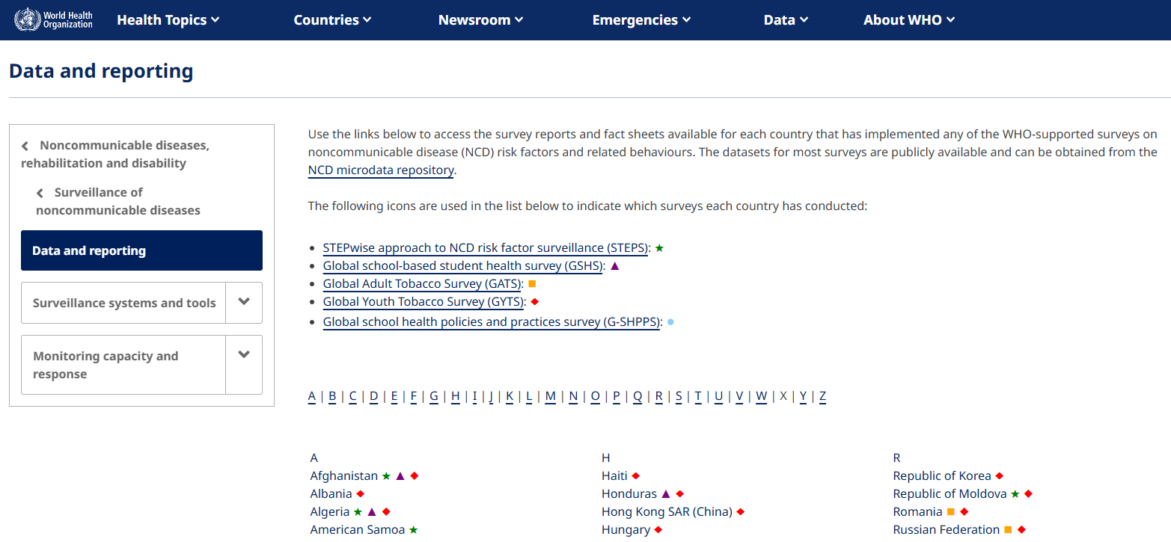
Overall physical activity
Global school health policies and practice survey (G-SHPPS) national factsheets available on the WHO data portal: https://www.who.int/teams/noncommunicable-diseases/surveillance/data

Slide 10
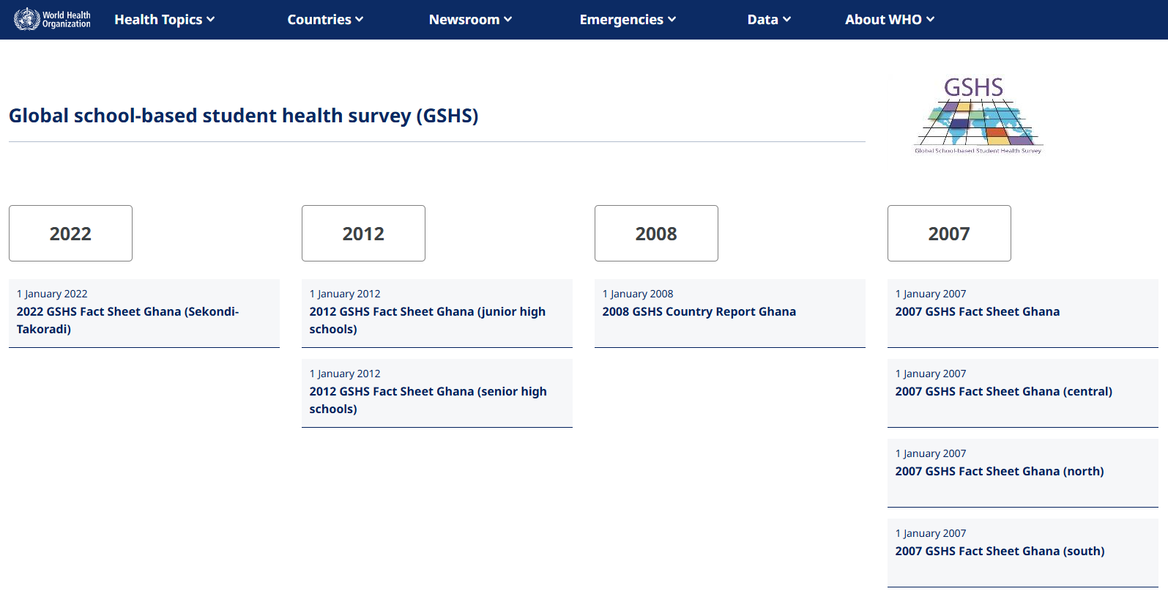
Overall physical activity
Global school-based student health survey (GSHS): Ghana example

Slide 11
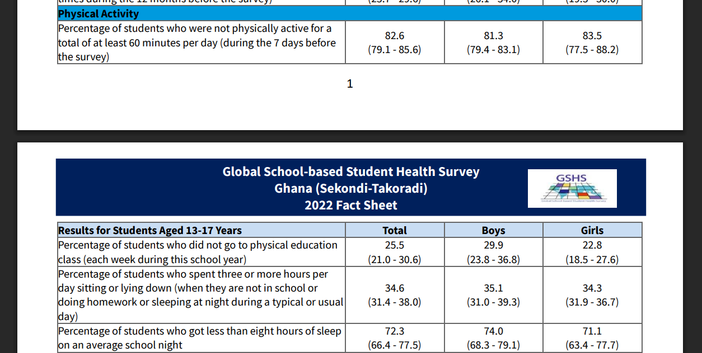
Overall physical activity
Global school-based student health survey (GSHS): Ghana example

Slide 12
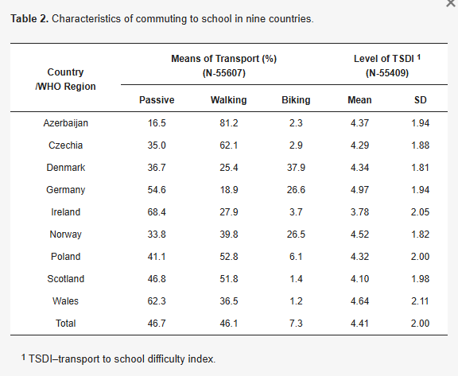
Active transportation
Mode of travel was assessed in HBSC 2017/2018 in some countries (not in 2022)
No official international HBSC report, some publications, probably national HBSC reports
E.g., Active Transport to School May Reduce Psychosomatic Symptoms in School-Aged Children: Data from Nine Countries
Students self-reported how they usually get to and from school. There were five mutually exclusive categories of answers: (1) on foot; (2) by bicycle; (3) by bus, train, tram, or metro; (4) by car, motorbike, or scooter; and (5) other means.

Slide 13
Active transportation
Active commuting was also assessed in the GSHS, but it is not reported in the national GSHS factsheets on the WHO data portal
Students self-reported how they usually get to and from school. There were five mutually exclusive categories of answers: (1) on foot; (2) by bicycle; (3) by bus, train, tram, or metro; (4) by car, motorbike, or scooter; and (5) other means.
Possible to download your country GSHS data on CDC portal!

Slide 14
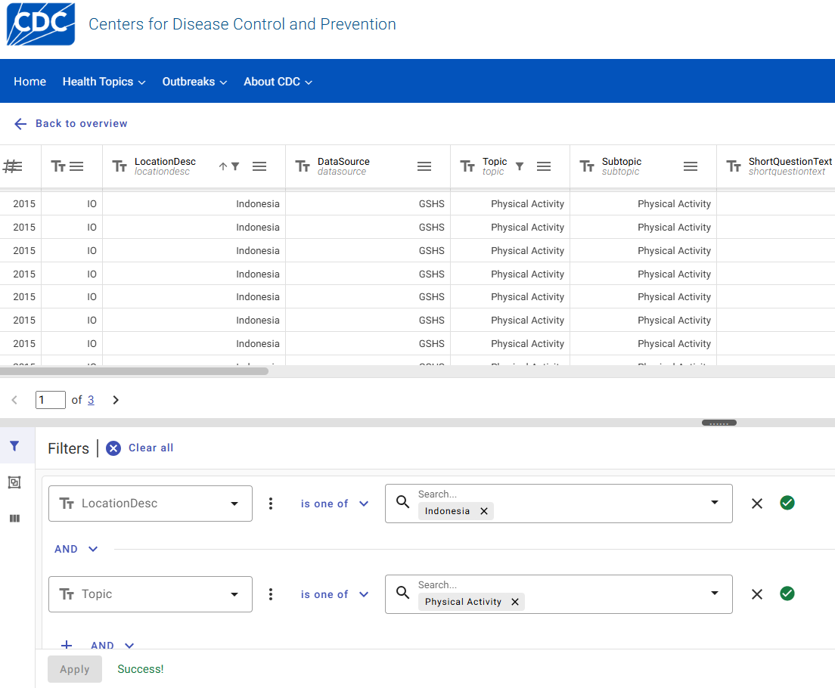
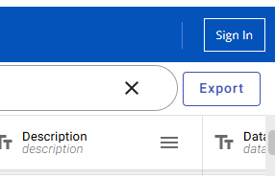
Available on this page
1. Select “Add a filter” here
4. Select “Add a filter” here
7. Final step, export the data here!
This will give you all the GSHS physical activity related indicator (PA, SB, AT) “reverse” prevalence, by year, sex, age or age group (e.g., “Did not walk or ride a bicycle to or from school”).
It takes some time to understand & familiarize yourself with the exported data.
2. Select your country here
5. Select “Physical Activity” here
3. & 6. Click on “Apply”

Slide 15
Sedentary behaviour
Global school-based student health survey (GSHS) national factsheets available on the WHO data portal: https://www.who.int/teams/noncommunicable-diseases/surveillance/data
Data for 13-17 years
No international data collection round, limitations in the standardization and translation of questionnaire & methods (sometime, PA questions missing, e.g. Malawi 2009)
Gender differences
Not accurately assessing the Global Matrix benchmark: “Percentage of students who spent three or more hours per day sitting and watching television, playing computer games, or talking with friends, when not in school or doing homework during a typical or usual day” (not consistently, sometimes it is just assessing “sitting”)
Also available with details by sex, year, age in the full GSHS dataset! (cf previous slide)

Slide 16
School
Global school health policies and practice survey (G-SHPPS) national factsheets available on the WHO data portal: https://www.who.int/teams/noncommunicable-diseases/surveillance/data
Percent of schools that teach students about physical activity and fitness
Percent of schools that teach physical education
Among schools teaching physical education, the percent of schools in which a physical education teacher or specialist provides most of the physical education instruction
Percent of schools that teach students about movement concepts and skills
Percent of schools that teach students about the value of physical activity for health, enjoyment, challenge, self-expression, and/or social interaction
Percent of schools that have a safe and clean indoor space and outdoor space for physical education class
Percent of schools that regularly provide recess or other physical activity breaks to students during the school day

Slide 17
School
Global school health policies and practice survey (G-SHPPS) national factsheets available on the WHO data portal: https://www.who.int/teams/noncommunicable-diseases/surveillance/data

Slide 18
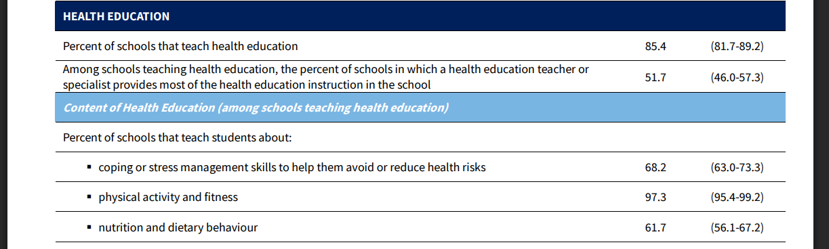
School
Global school health policies and practice survey (G-SHPPS) national factsheets available on the WHO data portal: Indonesia example

Slide 19
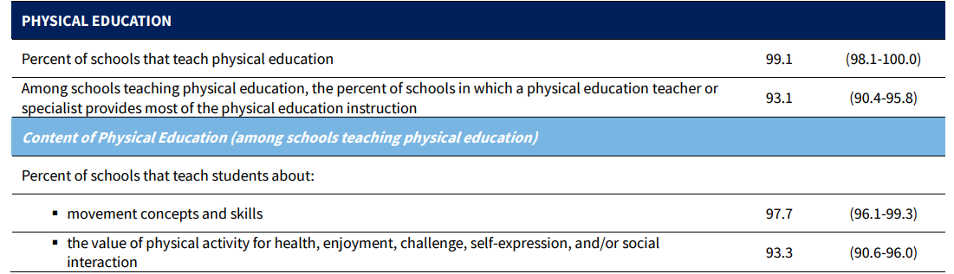
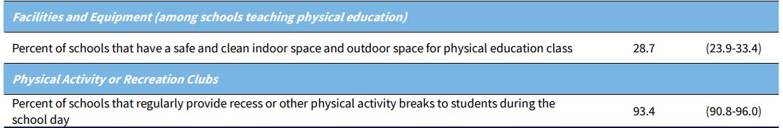
School
Global school health policies and practice survey (G-SHPPS) national factsheets available on the WHO data portal: Indonesia example

Slide 20
School
OECD Data portal: Instruction time per subject by level of education
Type of educational institution: Public educational institutions
Unit of measure: Percentage of compulsory instruction time
Education levels: Primary education; Lower secondary general education
Data refers to the reference year 2025 (school year 2024/25 or 2025)
Includes a few non-OECD countries

Slide 21

OECD Data portal
https://data-explorer.oecd.org/

Slide 22
School
OECD Data portal: Instruction time per subject by level of education
Type of educational institution: Public educational institutions
Unit of measure: Percentage of compulsory instruction time
Education levels: Primary education; Lower secondary general education
Data refers to the reference year 2025 (school year 2024/25 or 2025)
Includes a few non-OECD countries

Slide 23
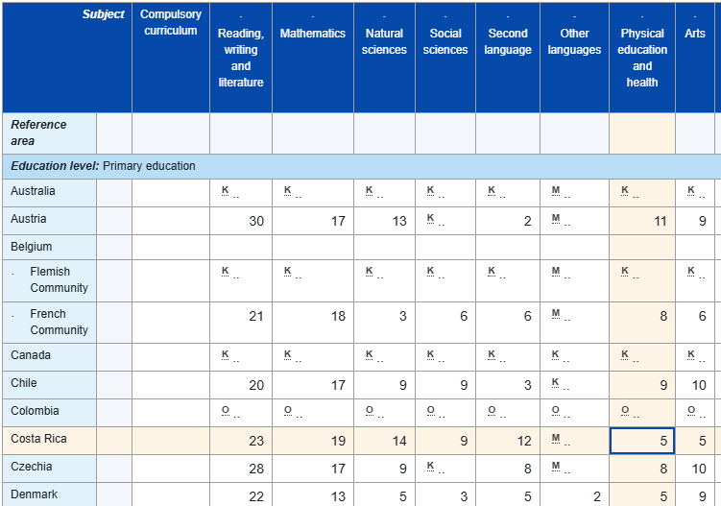
OECD Data portal
https://data-explorer.oecd.org/vis?lc=en&df[ds]=dsDisseminateFinalDMZ&df[id]=DSD_EAG_IT%40DF_EAG_IT_SUBJ_ISCED&df[ag]=OECD.EDU.IMEP&df[vs]=1.1&dq=....ISCED11_1%2BISCED11_24..&to[TIME]=false&vw=tb

Slide 24
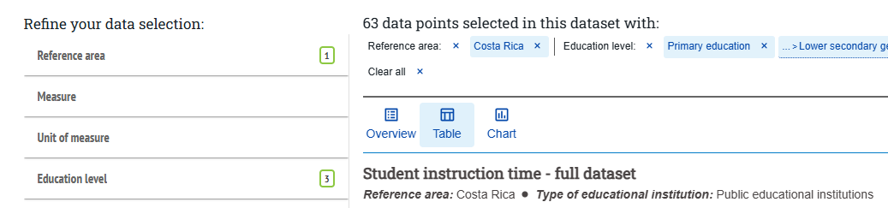
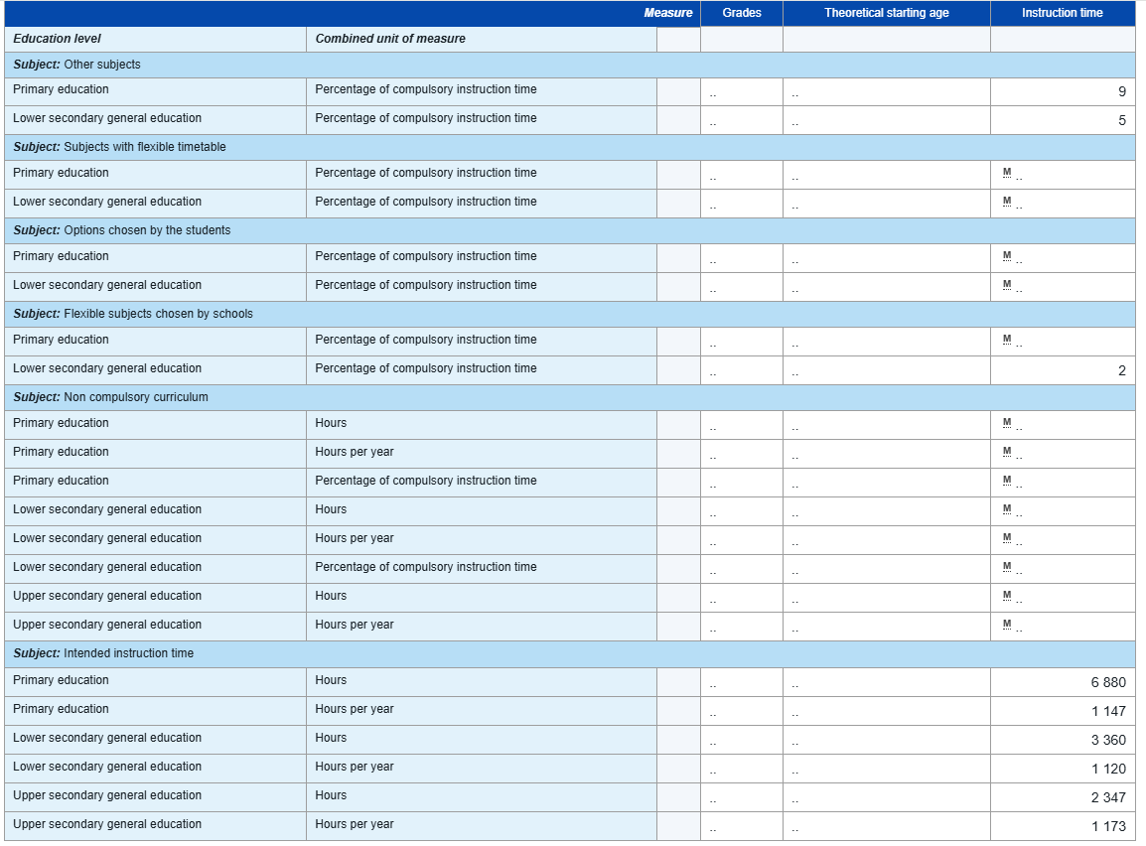
OECD Data portal
https://data-explorer.oecd.org/vis?pg=80&fs[0]=Topic%2C0%7CEducation%20and%20skills%23EDU%23&snb=107&fc=Topic&bp=true&df[ds]=dsDisseminateFinalDMZ&df[id]=DSD_EAG_IT%40DF_EAG_IT_ALL&df[ag]=OECD.EDU.IMEP&df[vs]=1.1&dq=CRI....ISCED11_1%2BISCED11_24%2BISCED11_34..&to[TIME]=false&vw=tb

Slide 25
Potential other sources of data
WHO European Childhood Obesity Surveillance Initiative (COSI): homepage Round 6 of COSI (2022–2024) – 48 participating countries listed here (page 2)
Collects nationally representative data in 6 to 9 years
Collected data on physical activity, sedentary behaviour, family background, and school (environmental) characteristics such as the frequency of physical education lessons, availability of school playgrounds, and current and ongoing school initiatives organised to promote a healthy lifestyle (healthy eating, physical activity) – potential small variation of included topics by countries
No available open access international data/report – some national reports can be found, e.g., Ireland. Maybe available national data can be shared upon reasonable request by your team? (eunutrition@who.int)

Slide 26
Potential other sources of data
Broaden Your Data Search
Don’t stop at the big surveys (HBSC, GSHS, OECD…) — explore further!
Scientific literature: look for small international studies (2+ countries), or cross-national comparisons that may include your country.
Grey literature: ministry reports, regional/local government publications, grassroots or NGO reports, white papers.
Contextual data: sometimes available in policy documents, annual education/sport/health reports, or even national statistics portals.

Slide 27
Potential other sources of data
How to Search Effectively
Use diverse keywords for each indicator (e.g., “active transportation” + “active commute” + “active travel” [country]”).
Review both scientific databases (PubMed, Scopus, Web of Science) and grey literature sources (Google Scholar, government/NGO websites).
Check for recent studies you may have missed — sometimes smaller, high-quality datasets exist.
Don’t forget to look at sub-national reports (regions, cities) if national data are not available.

Slide 28
Potential other sources of data
Share & Collaborate!
If you discover international or national data sources that are relevant beyond your own country, please share them with us
➡️ We will circulate them to other GM 5.0 countries
Remember: Report Card teams are the best experts to identify the most relevant local data

Slide 29
Auditing process

Slide 30
Audit overview
Grading decisions – by the Report Card teams (local experts)
Purpose of the audit - to review all countries’/jurisdictions’ Report Card grades by the
AHKGA team prior to their inclusion in the Global Matrix 5.0, ensuring:
Alignment with the Global Matrix Framework (indicator benchmarks, grading rubric)
Support by clear and transparent rationales (high-level summary of the evidence informing the grades)
Audit timeframe: September – December, 2025

Slide 31
Previous experience
Global Matrix 4.0
57 countries/jurisdictions, 570 grades
121/570 (21%) of grades were changed as a result of the audit (i.e., draft grades submitted to the AHKGA vs final grades included in the Global Matrix 4.0)​
Most grade adjustments (n=17) - Sedentary Behaviour indicator
Report Card Leaders' feedback on the audit process
In the Global Matrix 4.0 Final Evaluation Survey, most participants agree/strongly agree that:
feedback from the auditors was useful and informative (92%)
responses from the auditors came within a reasonable timeframe (93% )
the audit template was clear and easy to complete (95% )
Global Matrix 5.0 will follow a similar audit process to the Global Matrix 4.0

Slide 32
Audit process
Report Card leaders submit their draft grades and rationales to the AHKGA (by Dec 1, 2025)
AHKGA team reviews the draft grades and rationales and provides feedback to the Report Card leaders
​Use AHKGA's audit template
AHKGA's main contact for grades submission and related communications – Emily (estone@cheo.on.ca)
Recommends
clarifications/revisions
Approves the draft grades
= final grades
(by Dec 31, 2025)
Report Card leaders respond to the feedback
AHKGA includes final grades into
the Global Matrix 5.0 dataset
Global analyses start in January 2025

Slide 33
Audit template
Indicator | Overall grade | Rationale/ justification for the overall grade | Subgrade for children and adolescents with disabilities (CAWD) and/or chronic conditions | Rationale/ justification for the subgrade for children and adolescents with disabilities (CAWD) or chronic conditions | Disaggregated data for other sub-groups (sex/gender, socioeconomic status, age, location), where possible | Methodology | Main characteristics of data sources | References for data sources, where possible | AHKGA audit round 1 |  | Report Card team's response to reviewers' feedback
10 common indicators and Sleep (if assessed) | Add a * to your grade if it is based on mixed data: device-measured and reported; add ** to your grade if it is based on device-measured data exclusively | Provide a summary of findings (e.g., prevalence statistics, programs/policies) that informed the grade | Please provide a subgrade for CAWD. Add a * to your subgrade if it is based on mixed data: device-measured and reported; add ** to your subgrade if it is based on device-measured data exclusively | Provide rationales OR a summary of information (if available but not sufficient to assign a subgrade) | Provide sub-grades and rationales OR a summary of information (if available but not sufficient to assign a subgrade) | Specify which benchmark(s) were used. When multiple benchmarks or data sources were used, show how the grade was calculated, e.g., simple average, weighted average, expert consensus. When using the grading rubric, consider rounding your average prevalence statistics to a whole number (e.g., 59.6% to 60%, grade “B-“). | Include a short description of the data sources, e.g., study type, sample size, location/representativeness, data collection year. | In Vancouver style, preferably | Reviewer 1 feedback | Reviewer 2 feedback
Overall Physical Activity
Organized Sport
Active Play
...

Slide 34

Resources
Audit template
  https://docs.google.com/spreadsheets/d/1Y4igfZNhlK5aKPGCVeDmf6MENbJqFHGu/editusp=sharing&ouid=106138810618606714109&rtpof=true&sd=true
Completed audit template - Canadian example
  https://docs.google.com/spreadsheets/d/1RyCEb7dlSRdap-n4jl_oZCTIFjYYIed-/edit?usp=sharing&ouid=106138810618606714109&rtpof=true&sd=true
Global Matrix 5.0 grading rubric
  https://drive.google.com/file/d/1ehbCA5m5vVvs3Eu8NzsWVpDgAuRxDhXM/view?usp=sharing
Global Matrix 5.0 indicator definitions and benchmarks
  https://drive.google.com/file/d/1q3FGyTf_6Mi2lOB9gqyzzA7Wv47Vzy5c/view?usp=sharing
Previous webinar on the publication plan and updated indicators
  https://www.activehealthykids.org/2025/03/26/webinar-recording-available-here-publication-plan-and-updated-indicators-march-26-2025/
SPSS scripts for Physical Fitness indicator evaluation (e-blast #14, August)
  https://zenodo.org/records/16629038
Global Matrix 5.0 timeline
  https://drive.google.com/file/d/1DtuvaaznhSF_yIUBmelaLSk9aLPdqeZC/view

Slide 35
Timeline reminders

Slide 36
Important deadlines — Don’t miss out!
Deadline for ALL country final grades: December 31, 2025
Deadline for draft grades submission (to allow audit): December 1, 2025
Grades could go through several rounds of review!
Teams must be highly responsive to address any issues, errors, or concerns
Plan your work to allow 3 weeks of availability after first submission
If you plan to take holiday/winter/summer leave in December, submit your grades early to ensure you can respond during the audit
Failure to submit on time or failure to address audit revisions = ❌ removal from Global Matrix 5.0 and related publications!

Slide 37
Most frequently asked questions

Slide 38
Publication plan
Q: When will co-authors for the AHGKA led Global Matrix 5.0 papers be notified?
  A: Co-authors will be notified by the lead authors in mid-September.
Q: Who will co-author the Overall Physical Activity paper?
  A: All Report Card leaders will be invited to co-author the Overall Physical Activity paper.
Reminder: Report Card teams are highly encouraged to develop country/jurisdiction Report Card publications independently.

Slide 39
Audit
Q: Should a country/jurisdiction submit grades and rationales for additional indicators, such as Diet or Sleep, for audit by the AHKGA?
  A: It is encouraged for countries/jurisdictions to submit grades and rationales in the template for additional indicators. However, the AHGKA will not audit the grades for these indicators.

Slide 40
Indicator grades
Q: Should data on children and adolescents with disabilities (CAWD) be included in the overall grade for the indicator?
  A: Countries/jurisdictions should report:
    The main overall grade for each of the 10 core indicators should be based on the best available evidence, which would hopefully include CAWD.
    Subgrades for each of the 10 core indicators should be based on the best available evidence for only CAWD.
Q: Is there a standardized approach to the number of benchmarks used when grading an indicator?
  A: We encourage countries/jurisdictions to address as many benchmarks as possible, and average across the benchmarks that you are able to address. Situations can vary greatly across countries/jurisdictions.

Slide 41
Reminders
Keep up to date with the Members Area on the AHKGA website (https://www.activehealthykids.org/member-area/). All E-blasts and important documents (e.g., the grading rubric, audit template, indicator definitions and benchmarks, etc.) are posted there.
Please read, save and share all E-blasts with your team.

Slide 42
Any questions?

