Slide 1

Global Matrix 4.0
Spanish Report Card Leaders Meeting

Slide 2

Overview
Introductions
National Report Card
Regional Report Cards
First Country with Various Regions
National Coordination
Thoughts?

Slide 3


Introductions
  a. Spanish leaders introduction
        Leader/Co-leader name(s) and region
        Area of experience in relation to research involving children and adolescents

Slide 4

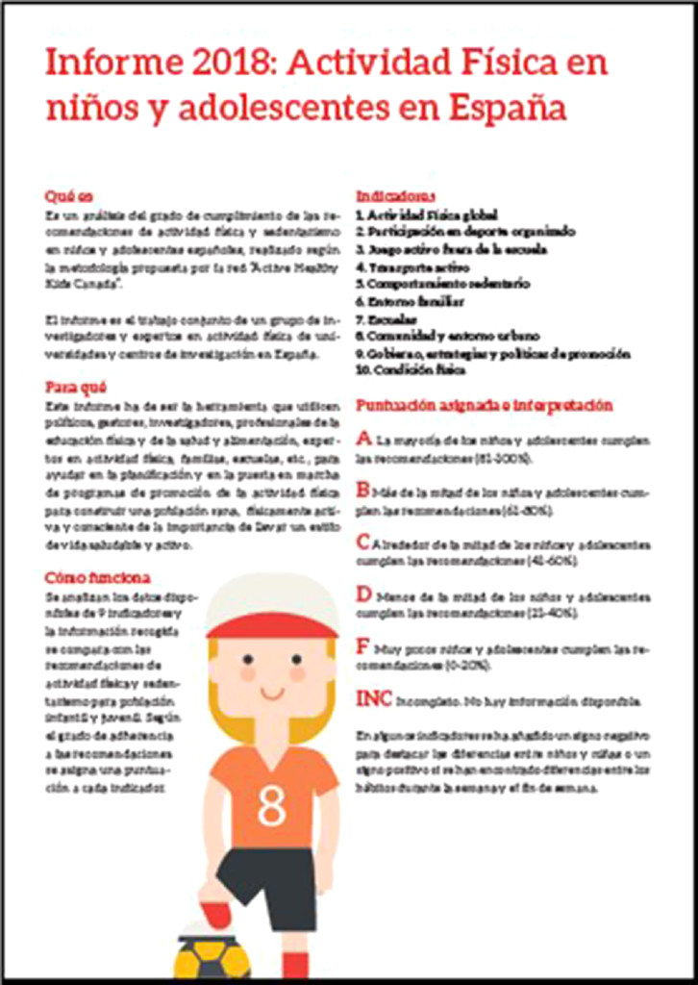
National Report Cards
  a. Previous National Report Cards
        2016 & 2018
  b. Current edition
        Spain (National) – Susana Aznar-Lain & Blanca Roman-Vinas
Roman-Viñas, B., Marin, J., Sánchez-López, M., Aznar, S., Leis, R., Aparicio-Ugarriza, R., Schroder, H., Ortiz-Moncada, R., Vicente, G., González-Gross, M., & Serra-Majem, L. (2016). Results From Spain’s 2016 Report Card on Physical Activity for Children and Youth, Journal of Physical Activity and Health, 13(s2), S279-S283.
Roman-Viñas, B., Zazo, F., Martínez-Martínez, J., Aznar-Laín, S., & Serra-Majem, L. (2018). Results From Spain’s 2018 Report Card on Physical Activity for Children and Youth, Journal of Physical Activity and Health, 15(s2), S411-S412.

Slide 5
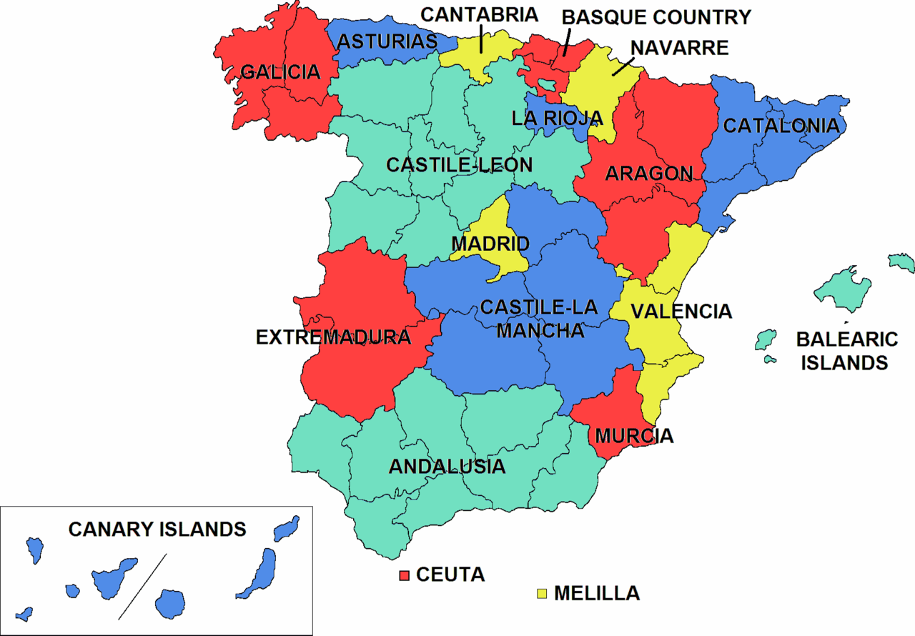
Regional Report Cards
  a. Basque Country
  b. Extremadura
  c. Region of Murcia
Source: https://commons.wikimedia.org/wiki/File:Ccaa-spain.png

Slide 6
Country with Various Regions
  a. Other countries
        UK – England, Scotland, and Wales (No national)
        China – China, Hong Kong, and Taiwan
  b. Opportunity for the future

Slide 7
National Coordination
  a. Why the need for this meeting?
        Share data/information
        Harmonize messaging and dissemination
  b. Coordination of launch dates
        Possibility to release simultaneously?
        At launch of Global Matrix 4.0? Post-Global Matrix 4.0 launch?
  c. Content coordination
        Additional indicators?
  d. Flow of information
        Communication between leaders
        Javier can help to facilitate

Slide 8

Thoughts?

Slide 9
Thank you!

