Slide 1
CONTENTS
SLIDE 2
Digital Poster Display Template
SLIDE 3
Digital Poster Display Template for Country Report Cards

Slide 2
MOVEMENT TO MOVE EVENT
Digital Poster Display Template for Country Report Cards
Use this template to create or insert your poster.
Display Area:
Posters will be displayed on electronic poster boards
Final screen is 55 inches
Poster displayed vertically (as per template)
Output resolution : 1080 x 1920
Format:
e-Posters must fit within this electronic template
e-poster layout should be clear and readable from a distance (we recommended 16-18pt font for text).
Use high resolution images
Your e-Poster Presentation Should Include:
Report Card title and all authors at the top of the poster
Brief introduction
Methods
Results
Conclusions/recommendations
Table of Grades
Image of your Report Card’s front cover
Country map
Country flag
References
Figure captions / explanations for graphs, images, and tables.

Slide 3
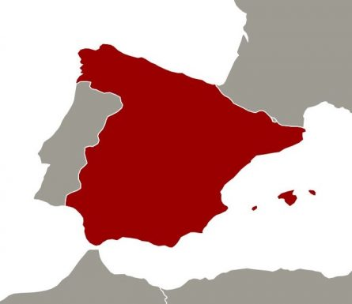
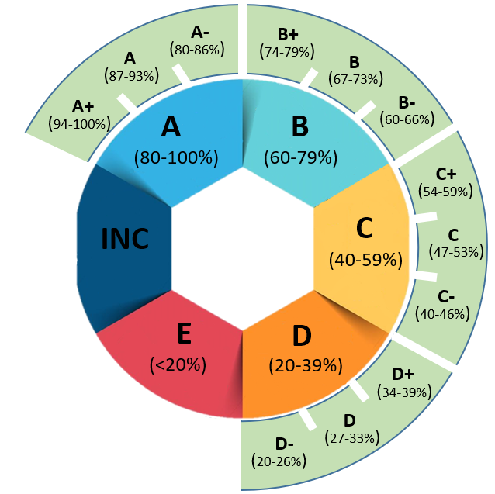
Physical Activity in children and adolescents: Spanish Report Card 2018
Fabio Jiménez-Zazo¹, Jesus Martinez-Martinez¹ Blanca Roman-Viñas^{2,3}, Susana Aznar-Laín¹ and Lluís Serra-Majem^{3,4}
1. PAFS Research group, University of Castilla-La Mancha, Toledo, Spain. 2. Nutrition Research Foundation, Barcelona, Spain. 3. CIBER Fisiopatología de la Obesidad y Nutrición (CIBERobn), Instituto de Salud Carlos III (ISCIII), Madrid, Spain. 4. Research Institute of Biomedical and Health Sciences, Department of Clinical Sciences, University of Las Palmas de Gran Canaria, Las Palmas de Gran Canaria, Spain.
Introduction
This Spanish Report Card updates the information analyzed in the 2016 Spanish Report card using the Active Healthy Kids methodology. The aim was to assess the level of physical activity guidelines achievement and sedentary behavior in Spanish children and adolescents.
Methods
The available data of 10 indicators referring to: physical activity, sedentary behavior, and their determinants, from the 2016 Spanish Report Card were analyzed.
The indicators included in the Spanish Report Card 2018 were: Overall Physical Activity Levels, Organized Sport Participation, Active Play, Active Transportation, Sedentary Behaviors, Family and Peers (infrastructure, support, parental/peer behaviors), School (infrastructure, policies, and programs), Physical Fitness, Community and the Built Environment (infrastructure, policies, programs, safety), and Government (strategies, policies, investments).
Fig 1. Grade for each indicator.
The grade for each indicator was based on the percentage of children and youth meeting a defined benchmark (see figure 1), following the procedures and methodology outlined by the Active Healthy Kids Canada Report Card model.
Indicators | Grades 2016 | Grades 2018
Overall Physical Activity Levels | D- | D
Organized Sport Participation | B | B
Active Play | C+ | C-
Active Transportation | C | B-
Sedentary Behaviors | D | B+
Family and Peers | INC | INC
School | C | C+
Physical Fitness |  | INC
Community and the Built Environment | INC | INC
Community and the Built Environment | INC | INC
Results
Overall physical activity was graded as D (27-33%), Organized Sports Participation as B (67-73%), Active Play as C- (40-46%), Active Transportation as B- (60-66%), Sedentary Behavior as B+ (74-79%), School as C+ (54-59%), Physical Fitness, Family and Peers, Community and the Built Environment, and Government strategies and investment were graded as Incomplete (see Table 1).
Conclusion
The results from the current Report card compared with 2016 Spanish Report card, showed a healthy improvement in Spanish children and adolescents in Active Transportation and Sedentary Behavior. Similar results were obtained in Overall physical activity, Organized Sports Participation and School. Active Play changed from C+ in 2016 to C- at present. Physical Fitness, Family and Peers, Community and the Built Environment and, Government strategies and investment indicators, need further research.
Table 1. Grades According to Physical Activity Indicator in the 2016 and 2018 Spanish Report Card on Physical Activity for Children and Youth.
Main data sources
1. Agencia Española de Seguridad Alimentaria y Nutrición. Ministerio de Sanidad, Servicios Sociales e Igualdad. Estudio ALADINO 2015 (Alimentación, Actividad física, Desarrollo Infantil y Obesidad). Madrid: Ministry of Health, Social Services and Equality, Spanish Food Safety and Nutrition Agency; 2016.
2. Rubio-López N, Llopis-González A, Picó Y, Morales-Suárez-Varela M. Dietary Calcium Intake and Adherence to the Mediterranean Diet in Spanish Children: The ANIVA Study. Int J Environ Res Public Health. 2017; 14 (6). doi: 10.3390/ijerph14060637.
3. Castro-Piñero J, Perez-Bey A, Segura-Jiménez V, Aparicio VA, Gómez-Martínez S, Izquierdo-Gomez R, Marcos A, Ruiz JR; UP&DOWN Study Group. Cardiorespiratory Fitness Cutoff Points for Early Detection of Present and Future Cardiovascular Risk in Children: A 2-Year Follow-up Study. Mayo Clin Proc. 2017; 92(12):1753-1762. doi: 10.1016/j.mayocp.2017.09.003.
4. Generalitat de Catalunya. Departament de Salut. Principals resultats 2016. Enquesta de salut de Catalunya. Comportaments relacionats amb la salut, l’estat de salut i l’ús de serveis sanitaris a Catalunya. Barcelona: Department of Health, Generalitat de Catalunya; 2016.

