Slide 1
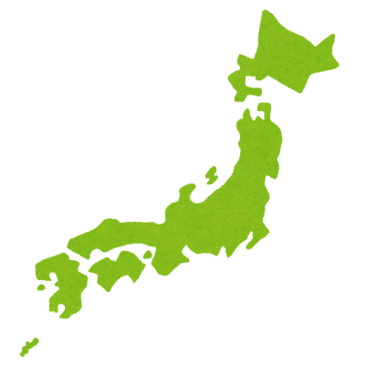

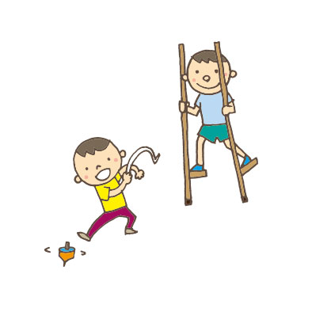
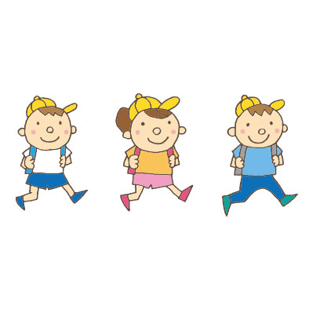
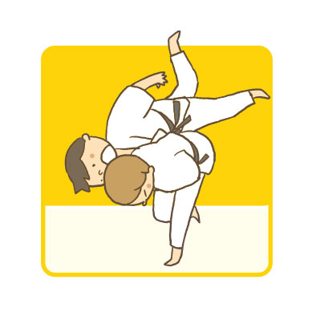



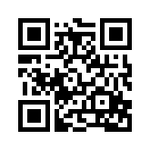


Results from the Japan 2018 Report Card on Physical Activity for Children and Youth
○Chiaki Tanaka¹, Shigeho Tanaka², Shigeru Inoue³, Motohiko Miyachi², Koya Suzuki⁴, Takafumi Abe⁵, John J Reilly⁶
¹ Division of Integrated Sciences, J. F. Oberlin University, Tokyo, Japan, ² National Institute of Health and Nutrition, National Institutes of Biomedical Innovation, Health and Nutrition, Tokyo, Japan, ³ Department of Preventive Medicine and Public Health, Tokyo Medical University, Tokyo, Japan, ⁴ Department of Sports Science, Juntendo University, Tokyo, Japan, ⁵ Center for Community-Based Healthcare Research and Education, Shimane University, Shimane, Japan, ⁶ Physical Activity for Health Group, School of Psychological Sciences & Health, University of Strathclyde, Glasgow, Scotland.
【Aim】
The 2018 Japan Report Card on Physical Activity for Children and Youth aims to consolidate existing evidence, encourage greater evidence-informed physical activity policy, and improve surveillance of physical activity.
【Methods】
The 2018 Japanese Report Card consists of 11 indicators. Nationally representative data were used to score the indicators. We used mainly the National Survey on Physical Fitness, Athletic Performance, and Exercise Habits of the Japan Sports Agency (JSA) using a questionnaire for a million students, and the Survey on Physical Strength and Athletic Performance of JSA using a questionnaire and measuring physical fitness in >2000 students for each grade.
【Key Findings】
The 2018 Japan Report Card on Physical Activity for Children and Youth consists of health behaviors and outcomes (7 indicators), and influences on health behaviors (4 indicators). The key four health behaviors and outcomes (Organized Sport Participation: B⁻; Active Transportation: A⁻; Physical fitness: A, Weight status: A) were favorable. Sedentary Behavior received C⁻ grade, while 2 indicators (Overall Physical Activity, and Active Play) could not be graded. In the Influences domain, Family Influence and Community were graded as C⁻, while School (B⁺), Community and Environment (B⁻), and Government Strategies and Investments (B) were favorable.
Table 1. Grades According to Physical Activity Indicator in the 2018 Japan Report Card on Physical Activity for Children and Youth
【Discussion】
The Japan report card illustrated some favorable health behaviors, health outcomes, and influences. There is a need for more evidence especially on overall physical activity levels and active play.
● ACKNOWLEDGMENTS : The authors thank members of the Stakeholder Group for their varied and substantial contributions to the 2018 Japan Report Card. This work was supported by a funding from the project research of Japanese Society of Physical Fitness and Sports Medicine (2015~2017) and J. F. Oberlin University.
Contact: c-tanaka@obirin.ac.jp
Active Healthy Kids Japan Website
http://activekids.jp/english/

